Slide 1
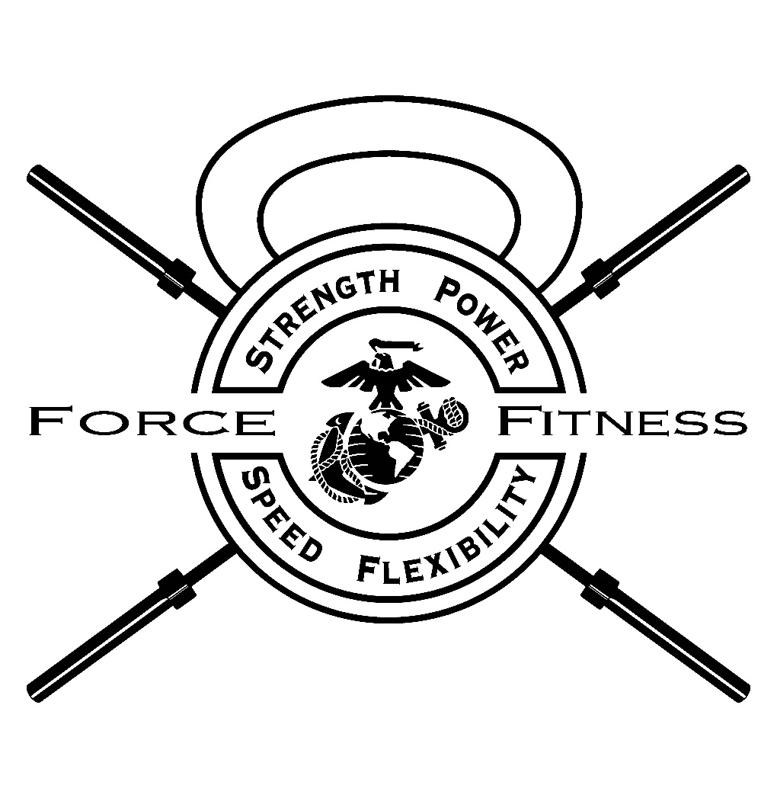
Force Fitness Program Overview

Slide 2

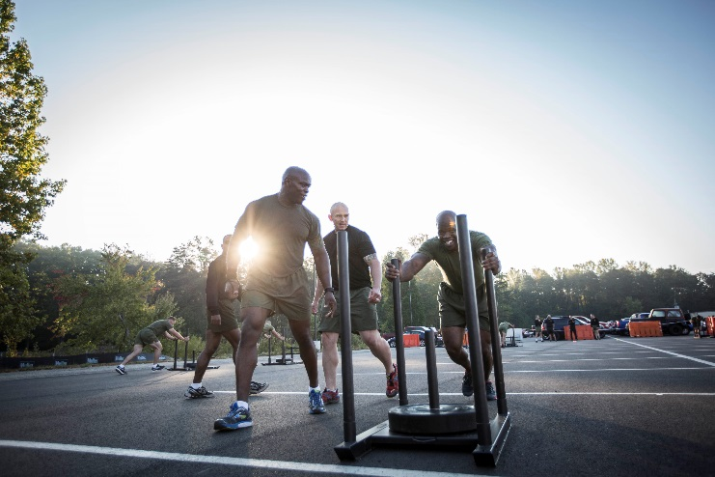
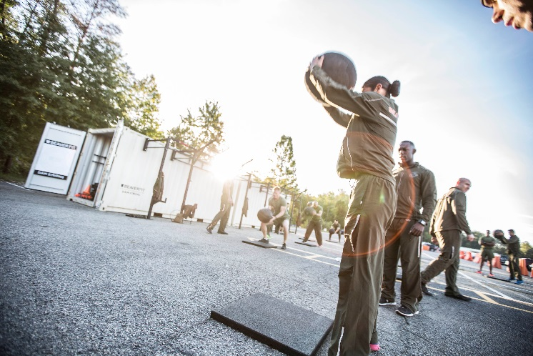
Why the need for a Force Fitness Program?
“…to be ready to fulfill our role as the Nation’s force-in-readiness, we require Marines who are smart, fit, disciplined, resilient, and able to adapt to uncertainty and to the unknown”
-MARADMIN 621/16

Slide 3

The Role of the Force Fitness Program
Principles of a well designed progressive program which need to be applied
- Prevent potential for injury
*Address flexibility issues
*Proper nutrition strategies
*Aid in recovery, regeneration and prevention
-Increase Performance which will
transfer to a tactical situation
-Builds strength, mobility, and speed
Notes:
*The 37th CMC recognized a problem within the Marine Corps as far as physical fitness. We have instructors for everything from rifle, swim, mcmap, MOS, Academy, etc., but we don’t have any subject matter experts in the field of physical fitness- an activity that Marines participate in corps wide on a daily basis.
*Insufficient knowledge has lead to ineffective training and increases in preventable injuries
*TECOM has developed the force fitness program which specializes in individual unit fitness programming that will be lead by the Force Fitness Instructor
*Force Fitness programming will aid each individual unit in achieving their specific METLs by training the Marines smartly which will, in turn, translate into a tactical situation on the battlefield.

Slide 4
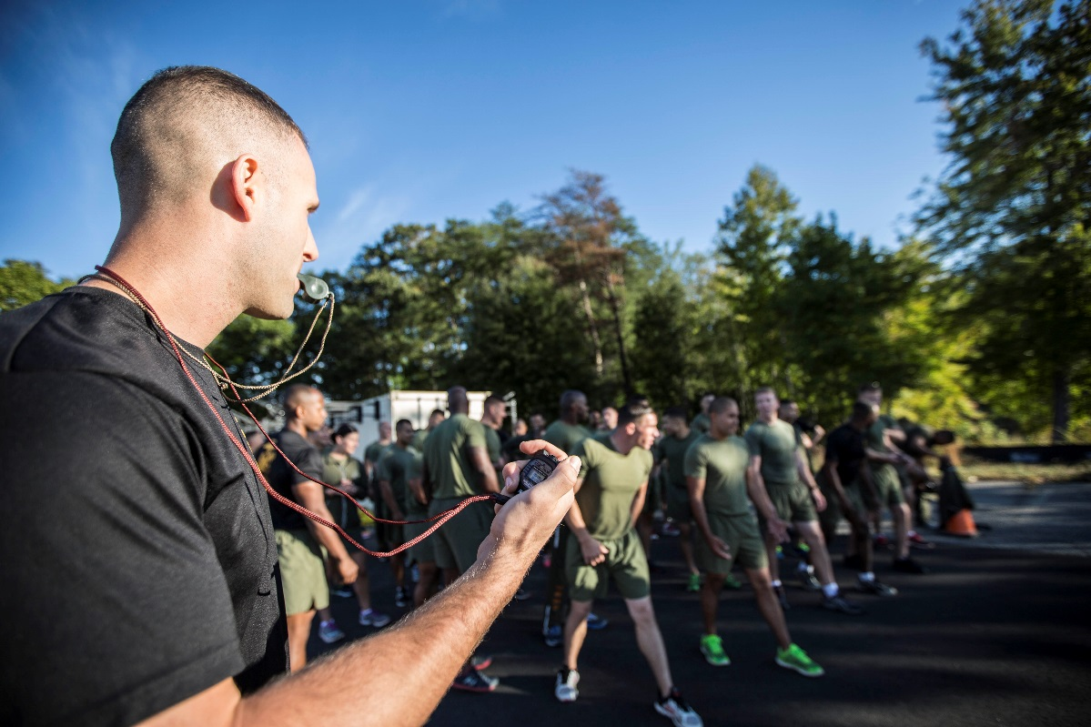
The Role of the Force Fitness Readiness Center
To produce Force Fitness Instructors with a knowledge in the areas of:
- Fitness Programming
- Injury Prevention
- Anatomy/Physiology
- Kinesiology
- Biomechanics
- Nutrition
Notes:
*The force fitness readiness center will provide a 6 week course to Marines in order to gain the secondary MOS of 0919, Force Fitness Instructor
*Students will earn hours of specialized lectures and practical application in the areas listed above.

Slide 5
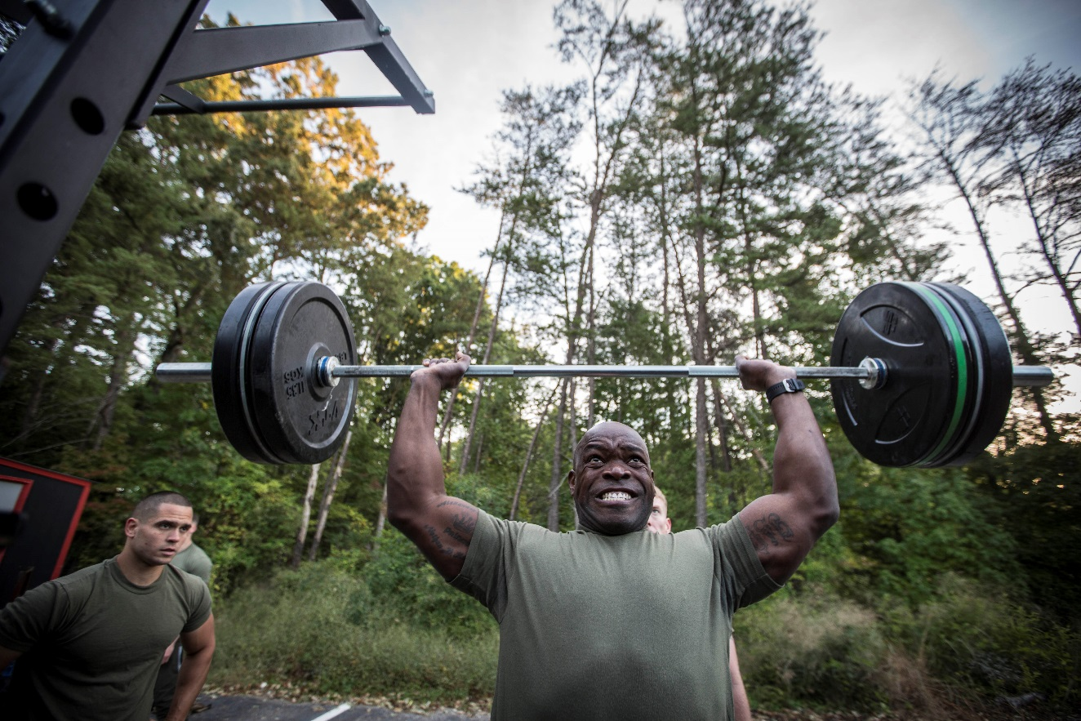
The Role of the Force Fitness Instructor
Subject matter expert in developing a unit physical fitness program
Unit Specific based on METLs
Reflective of TEEP
Utilizing risk assessment and
management
Including phases of strength,
speed, flexibility, and mobility
development
Notes:
*The force fitness instructor will return to their units and act as an advisor to the Commanding Officer on the areas of unit physical fitness programming’
*The FFI will develop a program that will cater to the unit’s TEEP, taking into account the units mission.
*The program will include specialized periodization training that will encompass the different phases of strength, speed, flexibility and mobility development
-The program will allow for smart progressive training in order to manage risk

Slide 6
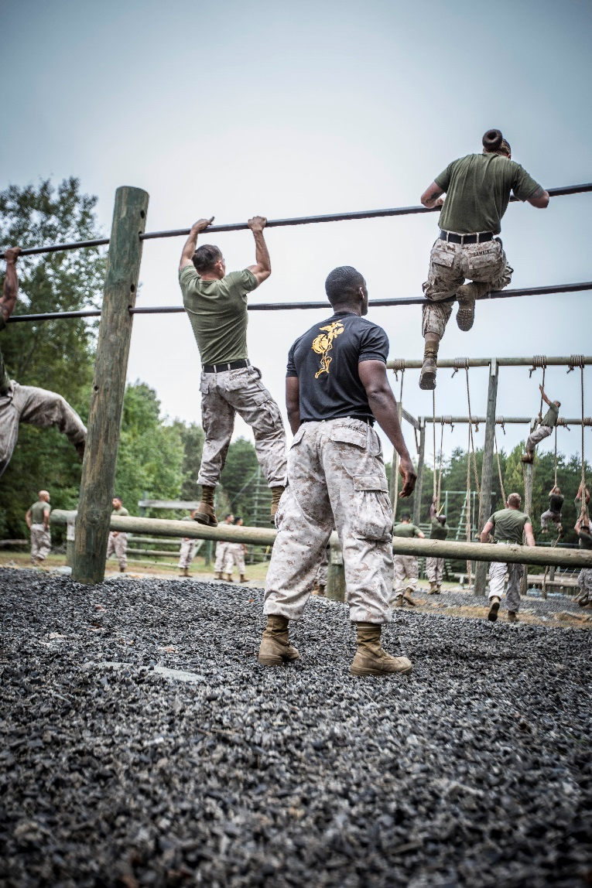
The Role of the FFI (cont.)
Assisted by unit CPTRs with:
-PFT/CFT monitoring and completion
-BCPMAP monitoring and enforcement
Provide Individual coaching and guidance to Marines
- BCPMAP guidance
- Individualized nutrition and fitness plans
- Provide minor injury recovery assistance
Notes:
*The FFI will be assisted by the unit CPTR in conducting and certifying PFT and CFTs
*The FFI will be able to offer individualized guidance to Marines within the unit with matters concerning fitness, nutrition, and overall wellness.
-This will include nutrition plans and individualized training programs
-Fitness plans will be catered to any pre-existing or current injuries
*The FFI will be able to offer minor rehabilitation to Marines that are suffering from current or past injuries

Slide 7
The Role of the Command
(hold for unit policy on physical fitness)
“Beginning 1 March 2017, Force Fitness Instructors along with supplemental instructors will begin the implementation of Combat Instructor Battalion’s (CIB) FFP. Force Fitness Instructors will implement CIB Force Fitness Program utilizing Force Fitness methodologies. Training is being conducted in order to increase unit/combat readiness, and to ensure the Battalion remains compliant with Marine Corps Order 6110.3, and 6100.13.”
Notes:
This slide will contain the mission statement on physical fitness from the student’s unit and the commanders intent.

Slide 8
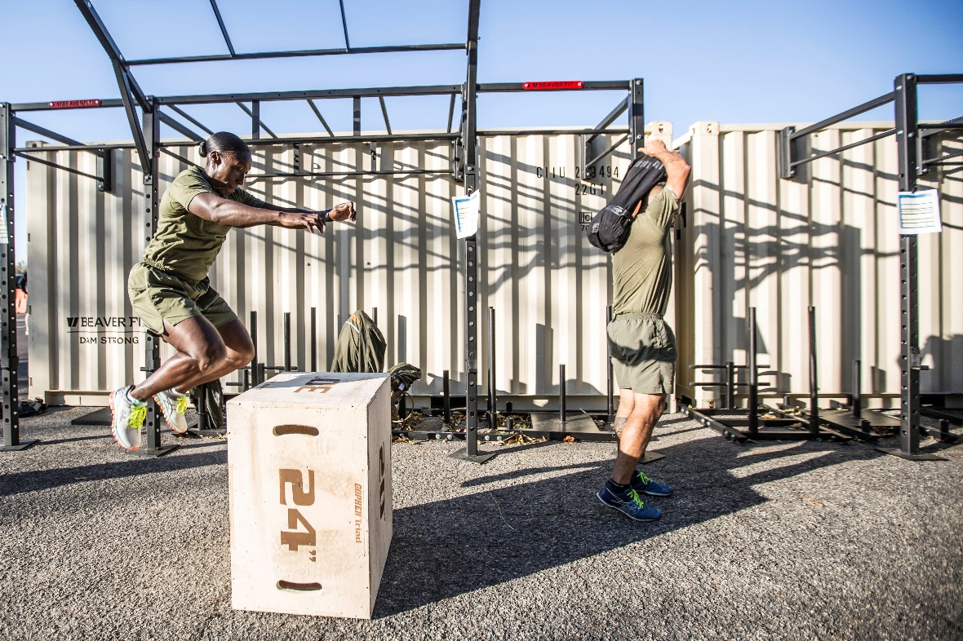
The Role of the Command
Embrace program and influence adaptation
Select appropriate Marines to attend training and carry out billet responsibilities
- Possess maturity, commitment,
leadership qualities
- Ability to lead and instruct
- Maintain physical and mental fitness
Notes:
(This slide will state how exactly the FFI will be able to enforce the commander’s intent)
*The command must embrace the commandant’s directive and aid in influencing the unit to follow suit.
*The command must ensure to send competent Marines through the FFIC
-Prereqs. (maintain elite physical fitness)
-Mature
-Ability to lead and instruct

Slide 9
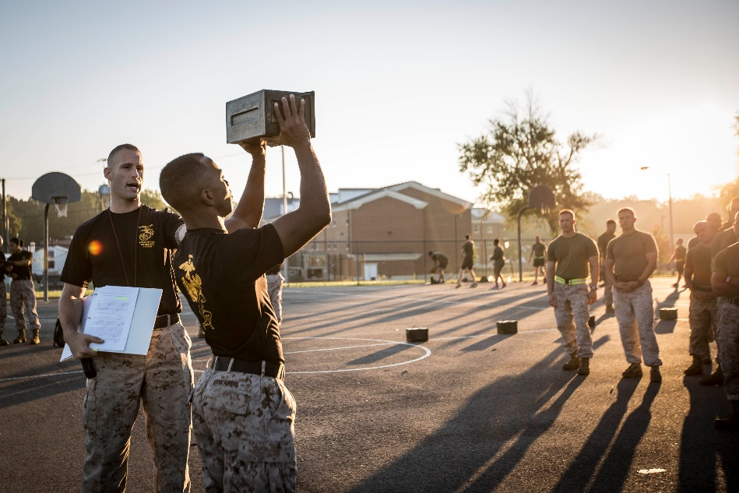
(Unit) Training Plan
*Force Fitness training plan will develop Marines to achieve peak performance for upcoming deployment
-1st Quarter: Hypertrophy
-2nd Quarter: Strength and Power development
*Foundational Strength
*Maximal Strength
*Explosive Power
*Muscular Endurance
-3rd Quarter: Peak Performance
*Applying strength to practical movements that will translate on the battlefield prior to 4th quarter deployment
Notes:
THIS IS AN EXAMPLE
*This slide will give the command a general overview of what your particular fitness program will look like long range.
*Explain the methodologies behind your programming
*Possibly provide an example of a few PT cards and explain the breakdown of the tiers
*Ensure training plan coincides with unit’s TEEP

Slide 10
Questions?

Slide 11
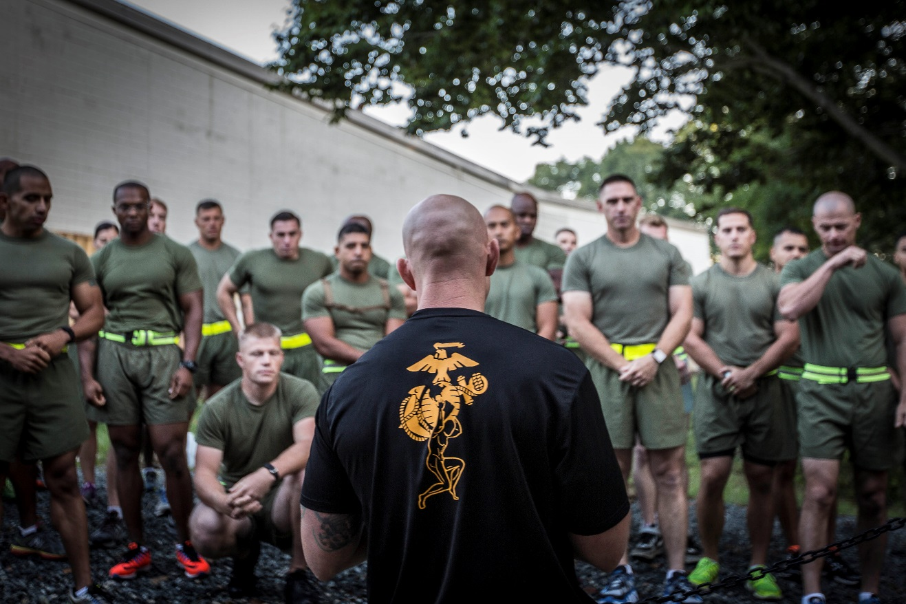
References
*MARADMIN 621/16
*MCBULL 6100
*MCBULL 6100.3A
*Fitness.Marines.mil

